Slide 1
Wireless Technologies (ZigBee and Mesh Wireless Networks)
Prepared By: Er. Amit Kr. Tewari
Associate Professor
CS Dept.
ACEIT, Jaipur

Slide 2
Basics
ZigBee is the commercial name for another PAN network technology based on the IEEE 802.15.4 wireless standard.
Like Bluetooth, it is a short-range technology with networking capability.
It was designed primarily for commercial, industrial, and home monitoring and control applications.

Slide 3
802.15.4 standard
The 802.15.4 standard defines the so-called air interface, which is the physical layer (PHY or layer 1 of the OSI standard) and the media access control (MAC or layer 2) of the system.
The ZigBee Alliance, an organization of chip, software, and equipment vendors of ZigBee products, specifies additional higher levels of layers including networking and security.
ZigBee is designed to operate in the license-free spectrum available in the world.

Slide 4
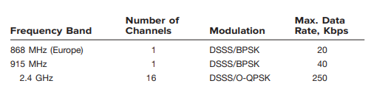
802.15.4 standard (Frequency Band)

Slide 5
802.15.4 standard (Features)
It is a technology of home networking. ZigBee is a technological standard created for controlling and sensor the network.
Low Power Consumption
Low Data Rate (20- 250 kbps)
Short-Range (75-100 meters)
Network Join Time (~ 30 msec)
Support Small and Large Networks (up to 65000 devices (Theory); 240 devices (Practically)
Low Cost of Products and Cheap Implementation (Open Source Protocol)

Slide 6
Zigbee Network Topologies
Star Topology
Mesh Topology
Tree Topology

Slide 7
Types of ZigBee Devices
Zigbee Coordinator Device – The ZC initiates a network formation. There is only one ZC per network.It communicates with routers. This device is used for connecting the devices.
Zigbee Router – It is used for passing the data between devices. The ZR serves as monitor or control device that observes a sensor or initiates off/on operations on some end device.
Zigbee End Device – It is the device that is going to be controlled. The ZED is simply an end monitor or control device that only receives data or transmits it.

Slide 8
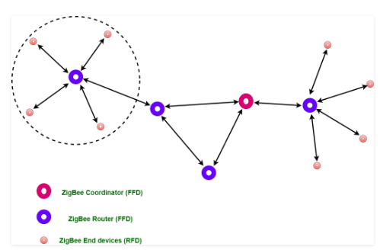

Slide 9
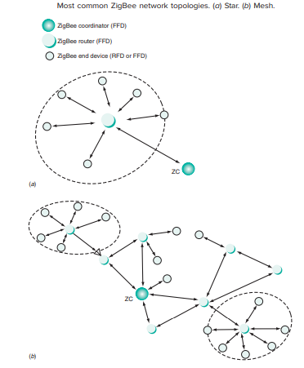

Slide 10
Zigbee Applications
Home Automation
Medical Data Collection
Industrial Control Systems

